Slide 1
Week# 09
Uncertainty in AI

Slide 2
Contents
Uncertainty
Probability
Syntax and Semantics
Inference
Independence and Bayes' Rule

Slide 3
Uncertainty
The cost of choosing
I need to be at the airport at 9:00 pm
◮ Agent 1: 95% chance of making it departing at 7:00pm
◮ Agent 2: 98% chance of making it departing at 8:00pm
◮ Agent 3: 100% chance of making it departing at 10:00pm Which one do you choose? Why?
Agent 2: 98% chance of making it departing at 8:00pm

Slide 4
Uncertainty
Example
What would need to happen in the KB to diagnose a cavity.
◮ Toothache ⇒ Cavity
◮ Toothache ⇒ Cavity ∨ GumProblem ∨ Abscess . . .
◮ Cavity ⇒ Toothache
But these can’t be true or complete...

Slide 5
Degree of Belief
Probabilities are a way to summarize uncertainty
◮ With the facts I can observe ...
◮ There’s 80% of chance of having a cavity

Slide 6
Decision Theory
Likelihood and Importance
Rational decisions involve:
◮ Likelihood of achieving a state/goal (probability)
◮ Relative importance of the states/goals (Utility)
Decision Theory = probability theory + utility theory
Maximum Expected Utility: An agent is rational iff it chooses the action that yields the highest expected utility, averaged over all the possible outcomes of the action.

Slide 7
Probabilities in AI
◮ Prob. require massive amount of data
◮ Use of prob. require enumeration of all possibilities
◮ Hides details of character of uncertainty
◮ People are bad prob. estimators
◮ We do not have those numbers
◮ We find their use inconvenient

Slide 8
Introducing Probabilities in AI
Probability= It is a measure of how likely the event is to happen
It lies between 0-1

Slide 9
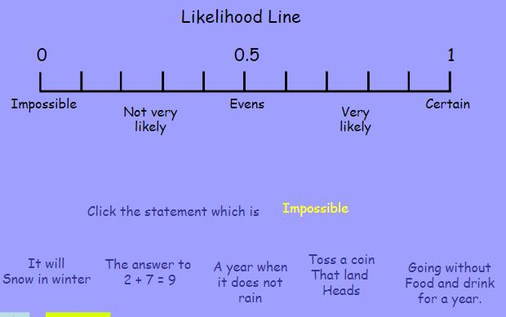
Probability

Slide 10
Probabilities
language of propositions
◮ Random Variable: variables like die₁, cavity , etc.
◮ Domain: The set of possible values for a variable. e.g.
die₁ = {1, 2, 3, 4, 5, 6}
What’s the domain of Weather , Cavity , Age³

Slide 11
Probabilities
A random variable can take on one of a set of different values, each with an associated probability. Its value at a particular time is subject to random variation.
Discrete random variables take on one of a discrete (often finite) range of values
Domain values must be exhaustive and mutually exclusive
For us, random variables will have a discrete, countable (usually finite) domain of arbitrary values.
Mathematical statistics usually calls these random elements
Example: Weather is a discrete random variable with domain
{sunny, rain, cloudy, snow}.
Example: A Boolean random variable has the domain {true,false},

Slide 12
Probability Distribution
Language
Let’s consider Weather = {sunny , rainy , cloudy , snow }
◮ P(sunny ) = 0.6; P(rain) = 0.1; P(cludy ) =
0.29; P(snow ) = 0.01
◮ P(Weather ) is a probability distribution.
Sunny rainy cloudy snow
◮ P(Weather ) =
0.6 0.1 0.29 0.01
◮ P(Weather ) =< 0.6, 0.1, 0.29, 0.01 > for short

Slide 13
Probabilities
Concepts
◮ Sample Space: All possible worlds
◮ dice roll: Ω = (1, 6)
◮ Ω = all possible worlds; ω = one world
◮ 0 ≤ P(ω) ≤ 1 for every ω
^{◮ P}_{ω∈Ω} P(ω) = 1m
Probability =No: of Favorable events/Total no; of events
What’s the possiblity of obtaining a head in a coin toss?
1/2
Possibility of odd numbers in Die?
e.g., P(1)=P(2)=P(3)=P(4)=P(5)=P(6)=1/6.

Slide 14
Probability
Axioms
Kolmorogorov’s axioms
◮ 0 ≤ P(ω) ≤ 1 for every ω and P _{ω∈Ω} P(ω) = 1
◮ P(¬a) =P _{ω∈¬a} P(ω)
◮ P(¬a) = 1 − P(a)
◮ P(a ∨ b) = P(a) + P(b) − P(a ∧ b)

Slide 15
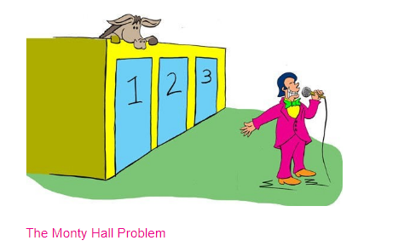
The Monty Hall Problem

Slide 16
Probabilities
More concepts and one example
◮ Unconditional/Prior Probabilities:P(dice are even) or
P(doubles)
◮ Evidence: Observed events. e.g. first die is 3.
◮ Conditional/Posterior probabily: given priors and evidence we compute the posterior.
◮ e.g. Prob of doubles given that first die is 3.
◮ P(doubles|die₁ = 3)
◮ P(cavity |toothache = T )

Slide 17
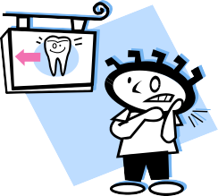
Joint probability distribution
Probability assignment to all combinations of values of random variables (i.e. all elementary events)
 | toothache | ¬ toothache
cavity | 0.04 | 0.06
¬ cavity | 0.01 | 0.89
The sum of the entries in this table has to be 1
Every question about a domain can be answered by the joint
distribution
!!!
Probability of a proposition is the sum of the probabilities of elementary events in which it holds
P(cavity) = 0.1 [marginal of row 1]
P(toothache) = 0.05 [marginal of toothache column]

Slide 18
Conditional Probability
 | toothache | ¬ toothache
cavity | 0.04 | 0.06
¬ cavity | 0.01 | 0.89
A
B
Ω
A ∧ B
P(cavity)=0.1 and P(cavity ∧ toothache)=0.04 are both prior
(unconditional) probabilities
Once the agent has new evidence concerning a previously unknown
random variable, e.g. Toothache, we can specify
a posterior (conditional) probability e.g. P(cavity | Toothache=true)
P(a | b) = P(a ∧ b)/P(b)
[Probability of a with the Universe Ω restricted to b]
→ The new information restricts the set of possible worlds ω_{i} consistent with it, so changes the probability.
So P(cavity | toothache) = 0.04/0.05 = 0.8
Where P(b) > 0

Slide 19
Conditional Probability (continued)
Definition of Conditional Probability:
P(a | b) = P(a ∧ b)/P(b)
Product rule gives an alternative formulation:
P(a ∧ b) = P(a | b) * P(b)
= P(b | a) * P(a)
A general version holds for whole distributions:
P(Weather,Cavity) = P(Weather | Cavity) * P(Cavity)

Slide 20
Probabilistic Inference
Probabilistic inference: the computation
from observed evidence
of posterior probabilities
for query propositions.
We use the full joint distribution as the “knowledge base” from
which answers to questions may be derived.
Ex: three Boolean variables Toothache (T), Cavity (C), ShowsOnXRay (X)
t
¬t
x
¬x
x
¬x
c
0.108
0.012
0.072
0.008
¬c
0.016
0.064
0.144
0.576
Probabilities in joint distribution sum to 1

Slide 21
Probabilistic Inference II
t
¬t
x
¬x
x
¬ x
c
0.108
0.012
0.072
0.008
¬c
0.016
0.064
0.144
0.576
Probability of any proposition computed by finding atomic events where proposition is true and adding their probabilities
P(cavity ∨ toothache)
= 0.108 + 0.012 + 0.072 + 0.008 + 0.016 + 0.064
= 0.28
P(cavity)
= 0.108 + 0.012 + 0.072 + 0.008
= 0.2
P(cavity) is called a marginal probability and the process of
computing this is called marginalization

Slide 22
Probabilistic Inference III
t
¬t
x
¬x
x
¬ x
c
0.108
0.012
0.072
0.008
¬c
0.016
0.064
0.144
0.576
Can also compute conditional probabilities.
P(¬ cavity | toothache)
= P(¬ cavity ∧ toothache)/P(toothache)
= (0.016 + 0.064) / (0.108 + 0.012 + 0.016 + 0.064)
= 0.4
Denominator is viewed as a normalization constant:
Stays constant no matter what the value of Cavity is.
(Book uses α to denote normalization constant 1/P(X), for random variable X.)

Slide 23
Combining Probabilities: the product rule
How we can work out the likelihood of two events occuring together given their base and conditional probabilities?
So in our toy example 1:
But this doesn’t help us answer our question:
“I have toothache. Do I have a cavity?”

Slide 24
Bayes’ rule
We can rearrange the two parts of the product rule:
This is known as Bayes’ rule.
It is the cornerstone of modern probabilistic AI.
But why is it useful?

Slide 25
Bayes’ Rule & Diagnosis
Likelihood Prior
_{P(a|b) =} P(b|a)*P(a)
P(b)
Posterior
Normalization
Useful for assessing diagnostic probability from causal probability:
P(Cause|Effect)
=P(Effect|Cause) * P(Cause)
P(Effect)

Slide 26
Bayes’ rule
We can think about some events as being “hidden” causes: not necessarily directly observed (e.g. a cavity).
If we model how likely observable effects are given hidden causes (how likely toothache is given a cavity)
Then Bayes’ rule allows us to use that model to infer the likelihood of the hidden cause (and thus answer our question)
in fact good models of are often available to us in real domains (e.g. medical diagnosis)

Slide 27
Bayes’ rule can capture causal models
Suppose a doctor knows that a meningitis causes a stiff neck in 50% of cases
She also knows that the probability in the general population of someone having a stiff neck at any time is 1/20
She also has to know the incidence of meningitis in the population (1/50,000)
Using Bayes’ rule she can calculate the probability the patient has meningitis:

Slide 28
The power of causal models
Why wouldn’t the doctor be better off if she just knew the likelihood of meningitis given a stiff neck? I.e. information in the diagnostic direction from symptoms to causes?
Because diagnostic knowledge is often more fragile than causal knowledge
Suppose there was a meningitis epidemic? The rate of meningitis goes up 20 times within a group
The causal model is unaffected by the change in P(m), whereas the diagnostic model P(m|s)=1/5000 is now badly wrong.

Slide 29
Bayes rule: the normalisation short cut
If we know P(effect|cause) for every cause we can avoid having to know P(effect)
Suppose for two possible causes of a stiff neck, meningitis (m) and not meningitis (¬m)
We simply calculate the top line for each one and then normalise (divide by the sum of the top line for all hypothesises
But sometimes it’s harder to find out P(effect|cause) for all causes independently than it is simply to find out P(effect)
Note that Bayes’ rule here relies on the fact the effect must have arisen because of one of the hypothesised causes. You can’t reason directly about causes you haven’t imagined.

Slide 30
Bayes’ rule: combining evidence
Suppose we have several pieces of evidence we want to combine:
John rings and Mary rings
I have toothache and the dental probe catches on my tooth
How do we do this?
As we have more effects our causal model becomes very complicated (for N binary effects there will be 2^{N} different combinations of evidence that we need to model given a cause)

Slide 31
Bayes rule + conditional independence
In many practical applications there are not a few evidence variables but hundreds
Thus 2^{N} is very big
This nearly led everyone to give up and rely on approximate or qualitative methods for reasoning about uncertainty
But conditional independence helps
Toothache and catch are not independent, but they are independent given the presence or absence of a cavity.
In other words we can use the knowledge that cavities cause toothache and they cause the catch, but the catch and the toothache do not cause each other (they have a single common cause).

Slide 32
The Solution: Independence
Random variables A and B are independent iff
• P(A ∧ B) = P(A) * P(B)
equivalently: P(A | B) = P(A) and P(B | A) = P(B)
A and B are independent if knowing whether A occurred gives no information about B (and vice versa)
Independence assumptions are essential for efficient probabilistic reasoning
Cavity
Toothache
Weather
Cavity
Toothache
Xray
Xray
decomposes into
Weather
P(T, X, C, W) = P(T, X, C) * P(W)
∙15 entries (2⁴-1) reduced to 8 (2³-1 + 2-1)
For n independent biased coins, O(2^{n}) entries →O(n)

Slide 33
Conditional Independence
BUT absolute independence is rare
Dentistry is a large field with hundreds of variables, none of which are independent. What to do?
A and B are conditionally independent given C iff
• P(A | B, C) = P(A | C)
• P(B | A, C) = P(B | C)
• P(A ∧ B | C) = P(A | C) * P(B | C)
Toothache (T), Spot in Xray (X), Cavity (C)
None of these are independent of the other two
But T and X are conditionally independent given C

Slide 34
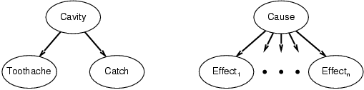
Bayes’ nets
This can be captured in a picture, where the arcs capture conditional independence relationships
Or in a new equation:
Using conditional independence the causal model is much more compact. Rather than the number of parameters being O(2^{N}) it is O(N) where N is the number of effects (or evidence variables)

Slide 35
Summary
Reasoning under uncertainty is an important area of AI
It is not the case that statistical methods are the only way
Logics can also cope with uncertainty in a qualitative way
But statistical methods, and particularly Bayesian reasoning has become a cornerstone of modern AI (rightly or wrongly)

